Slide 1
Video Generation with ComfyUI
DAZE
April 5

Slide 2
Current Popular Video Generation models
1. Sora (OpenAI, Feb 2024)
A powerful text-to-video model generating up to 60-second, 1080p videos with realistic physics, motion, and scenes. Based on diffusion transformers and video patches.
2. Runway Gen-2 (Mar 2023)
Supports text-to-video, image-to-video, and video-to-video generation. Outputs up to 18 seconds with creative modes like Storyboards and Director Mode.
3. HunyuanVideo (Tencent, Oct 2023)
High-quality text-to-video model from Tencent. Generates 16s videos with smooth motion and consistent object appearance using 3D spatiotemporal attention.
4. Wan2-1 (Shanghai AI Lab, Dec 2023)
Chinese multi-modal video generator supporting text, image, and video inputs. Focused on high-resolution, multilingual, and controllable outputs.

Slide 3
Current Popular Video Generation models
5. Pika Labs 2.1 (Jan 2024)
Popular creative tool for generating videos from text or image prompts. Offers Scene Ingredients, multiple aspect ratios, and up to 1080p quality.
6. Kling (Kuaishou, Feb 2024)
Chinese text-to-video model with strong realism, motion physics, and multi-shot coherence. Competes with Sora in quality and length.
7. CogVideo (Tsinghua, May 2022)
An early bilingual text-to-video model using a transformer-based pipeline. Produces up to 4-second low-res clips.

Slide 4
DWpose → Motion-driven Video
What it does: Controls the video based on human pose/keypoints.
Video Style: Clear and natural body movement, perfect for something like Tai Chi where the flow of motion matters.
Pros:
Realistic, natural movements.
Allows smooth transitions in poses (e.g. slow Tai Chi sequences).
Cons:
Lacks visual detail (e.g., face, clothes, background).
Only controls motion—not style or background.
✅ Best for: Character animation, motion mimicry (e.g., generating a Tai Chi routine from real poses).

Slide 5
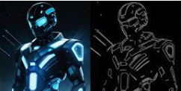
Canny → Edge-guided Video
What it does: Extracts image outlines to guide generation.
Video Style: Artistic, sketchy, cartoon/comic-like.
Pros:
Clear structure and line consistency.
Great for stylized, painterly, or comic-style videos.
Cons:
Not very realistic.
Poor motion control—poses might not align perfectly across frames.
✅ Best for: Artistic or stylized videos—sketch animations, hand-drawn looks.

Slide 6
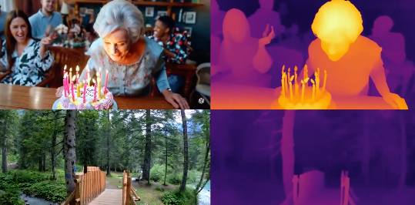
DepthCrafter → Depth-aware Video
What it does: Generates a depth map of the scene, helping the model understand spatial structure.
Video Style: Realistic 3D parallax and depth—like a scene with camera movement.
Pros:
Strong sense of space (foreground vs background).
Excellent for scenes with camera zoom or panning.
Cons:
Doesn’t control motion—just spatial structure.
If depth is inaccurate, distortion may occur.
✅ Best for: 2.5D videos, fake 3D animations, depth-based camera effects.

Slide 7
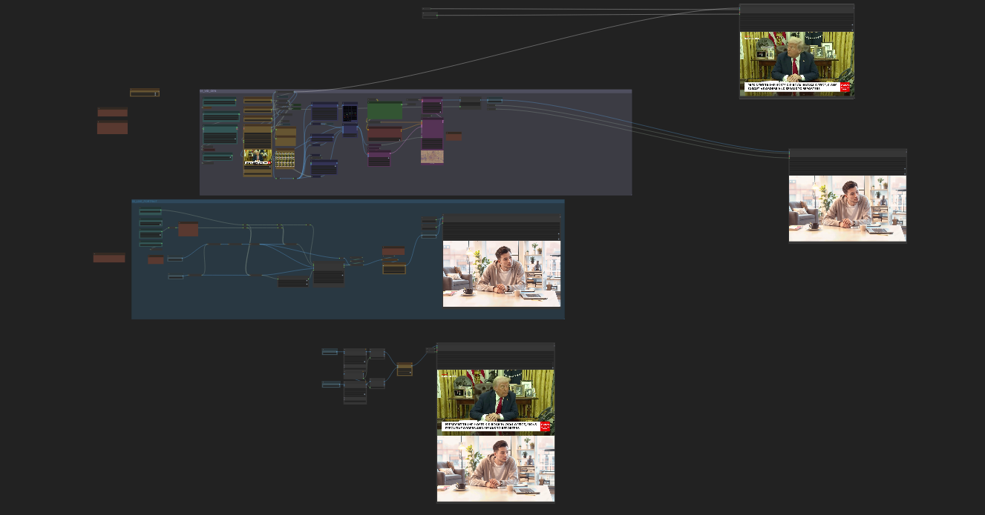
demo

Slide 8
Main components of ComfyUI - clip
CLIP (Contrastive Language–Image Pretraining) is mainly used to understand the relationship between text and images. In generation workflows, CLIP helps by:
1. Text-guided generation (Prompt embedding)
It converts your text prompt into an embedding (a numerical vector) that guides the image generation process.
2. Text-image matching / alignment
CLIP has learned the relationships between text and images during training, so it can “understand” what kind of image a piece of text is describing.
3. Used in LoRA, control modules, or specific model tuning (like CogVideoX)
Some models or LoRAs require a specific CLIP model to function properly or to follow a certain visual style.

Slide 9
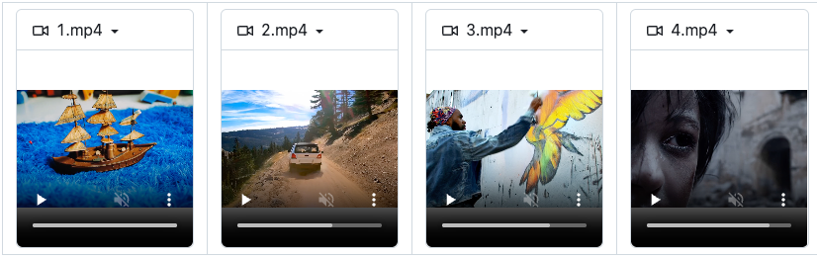
Main components of ComfyUI - CogVideoX
CogVideoX is an advanced open-source text-to-video and image-to-video generation model developed by THUDM. It builds on the original CogVideo architecture and introduces a series of upgrades, including better performance, higher resolution output, and support for flexible resolutions and quantization.

Slide 10
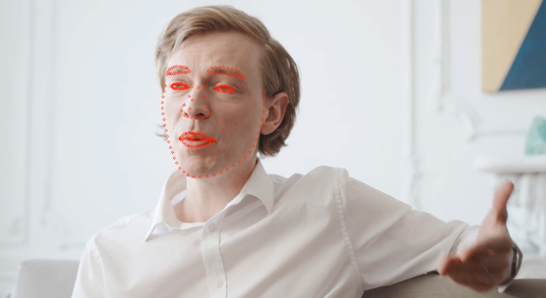
Main components of ComfyUI - LivePortrait
LivePortrait is a powerful extension for ComfyUI that brings real-time animation capabilities to still images. It lets you animate a static portrait using webcam input, video, or other driving sources, enabling image-to-video, video-to-video, and live webcam driven motion transfer. It's particularly tailored for facial animation, offering smooth, responsive, and expressive results.

Slide 11
Reference
[1] https://github.com/THUDM/CogVideo
[2] https://github.com/kijai/ComfyUI-LivePortraitKJ

